Slide 1
Balancing Equations

Slide 2
By the end of this lesson, you should be able to:
• | Understand the process of balancing an equation.
• | Identify whether an equation is balanced or unbalanced.
• | Balance an equation by determining how many of each atom is needed on both sides of the equation.

Slide 3
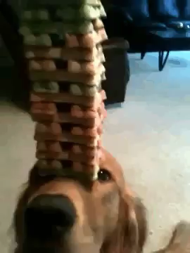
According to the Law of Conservation of Mass, the mass of the reactants must be equal to that of the products.
This also means the number and type of atoms stays the same.
This needs to be reflected in the chemical equations, with the same number and type of atoms on the left (reactant) and right (product) side of the equation.
When chemical equations have the same number and type of atoms on each side, they are considered balanced.

Slide 4

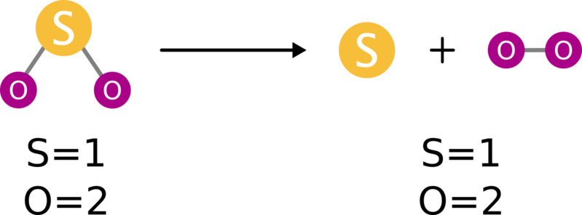
For example, the equation for the decomposition of sulfur dioxide to sulfur and oxygen is a balanced equation:
We can tell it is balanced because we can count the same number and type of atoms on each side.
Both have 1 sulfur and 2 oxygen atoms.
Sometimes this is easier to see using the molecular equation:

Slide 5
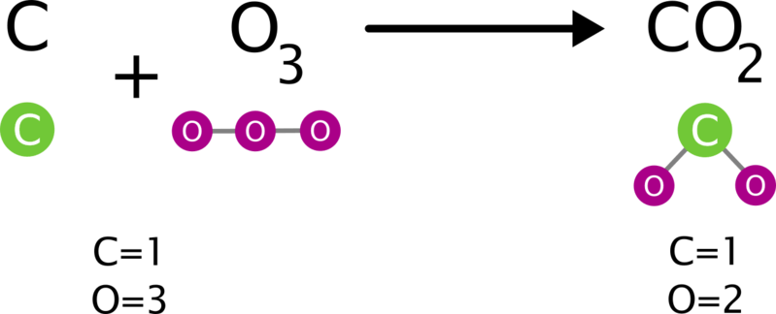
In this example, carbon is reacting with ozone to form carbon dioxide.
If we count the atoms on both sides, we can see that the equation is unbalanced.
There are 3 oxygen atoms on the left, but only 2 on the right.

Slide 6

Let's have a look at how to write balanced equations using an example chemical reaction.
If we mix hydrogen and oxygen together and add heat, we can make water.

Slide 7


We start by writing out the word and chemical equations.
First we write the word equation:
Then we insert the chemical symbols for hydrogen (H_{2​}), oxygen (O₂​) and water (H₂​O) to get a chemical equation:

Slide 8
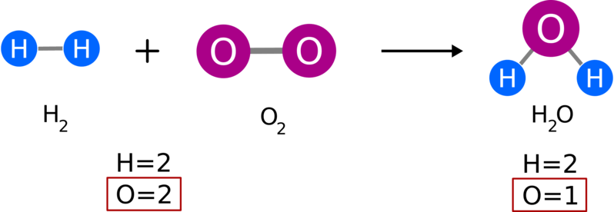
By just replacing the names of the substances with their chemical symbols, we get this chemical equation:
Can you see something wrong with it?
If we count each type of atom, we can see there are two oxygen atoms in the reactants and only one in the products.
It is unbalanced.

Slide 9
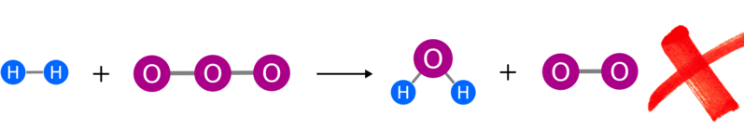
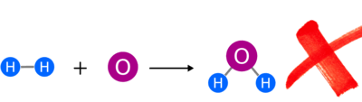
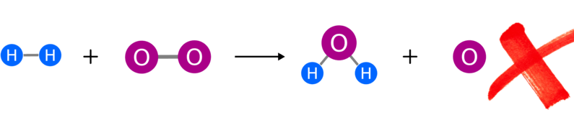
When fixing an unbalanced equation, you cannot change the molecules.
Just as chemical reactions make new substances out of old ones by rearranging their atoms, changing the molecules in our equation would make them different substances.
Here are some incorrect ways you may be tempted to try and balance the equation:

Slide 10
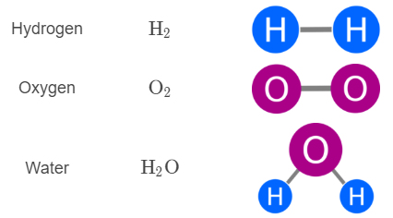
So we have to balance the equation using only these three molecules:
H_{2​}, O₂​ and H₂​O.
To do this, you add molecules until each side of the equation has the same number of each type of atom (eg. hydrogen and oxygen).
Basically, you are adding more reactant or product until the equation balances out. Reactant substances are always added to the reactant side, and products to the product side.

Slide 11
Let us look at our unbalanced equation again:
H₂​ + O₂​ → H₂​O
We need another oxygen on the product side, so we should add a molecule containing oxygen.
(One of these: H_{2​}, O₂​ or H_{2​}O)
Water (H2​O) is the only product, so let us add a water molecule.

Slide 12
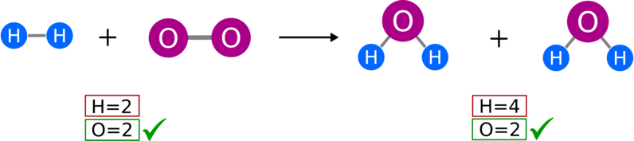
Our equation is still unbalanced. This time there are two more hydrogen atoms on the right than on the left:
H_{2​} + O₂​ → H₂​O + H_{2​}O
We need to add a molecule with hydrogen (H) to the reactant side.
(H₂​, O_{2​} or H₂​O)
Our reactants are hydrogen (H) and oxygen (O). We cannot add a water molecule (H₂​O) because it is a product.

Slide 13
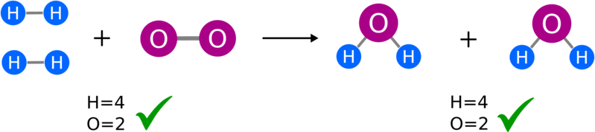
Finally our equation is balanced!
Both sides have four hydrogen atoms and two oxygen atoms.
H₂​ + H_{2​} + O₂​ → H₂​O + H₂​O

Slide 14
The last step in balancing equations is to simplify them.
H₂​ + H₂​ + O₂​ → H₂​O + H₂​O
To do this, we combine molecules of the same type together and place numbers in front of the entire molecule to show how many of that molecule there are. These numbers are called coefficients.

Slide 15
In summary, you balance equations using the following steps:
1. Write the chemical equation (write the word equation first and insert the chemical symbols if you are having difficulty).
2. Balance the equation by adding more reactant or product molecules. Do NOT modify these molecules. Add reactants to the left and products to the right.
3. Simplify the equation by combining molecules of the same type. Place a coefficient in front of the molecule to show how many of that molecule there had been.
And then you are done!

